Slide 1
POLYGON RENDERING
Ms.P. mahalakshmi
Assistant professor
Department of computer science and engineering

Slide 2
POLYGON RENDERING TYPES
CONSTANT SHADING
GOURAUD SHADING
PHONG SHADING

Slide 3
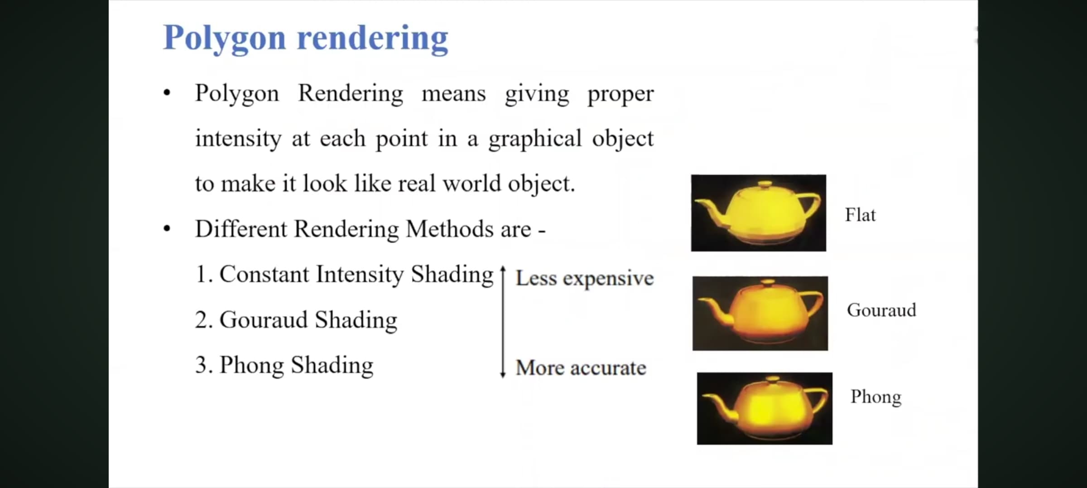

Slide 4
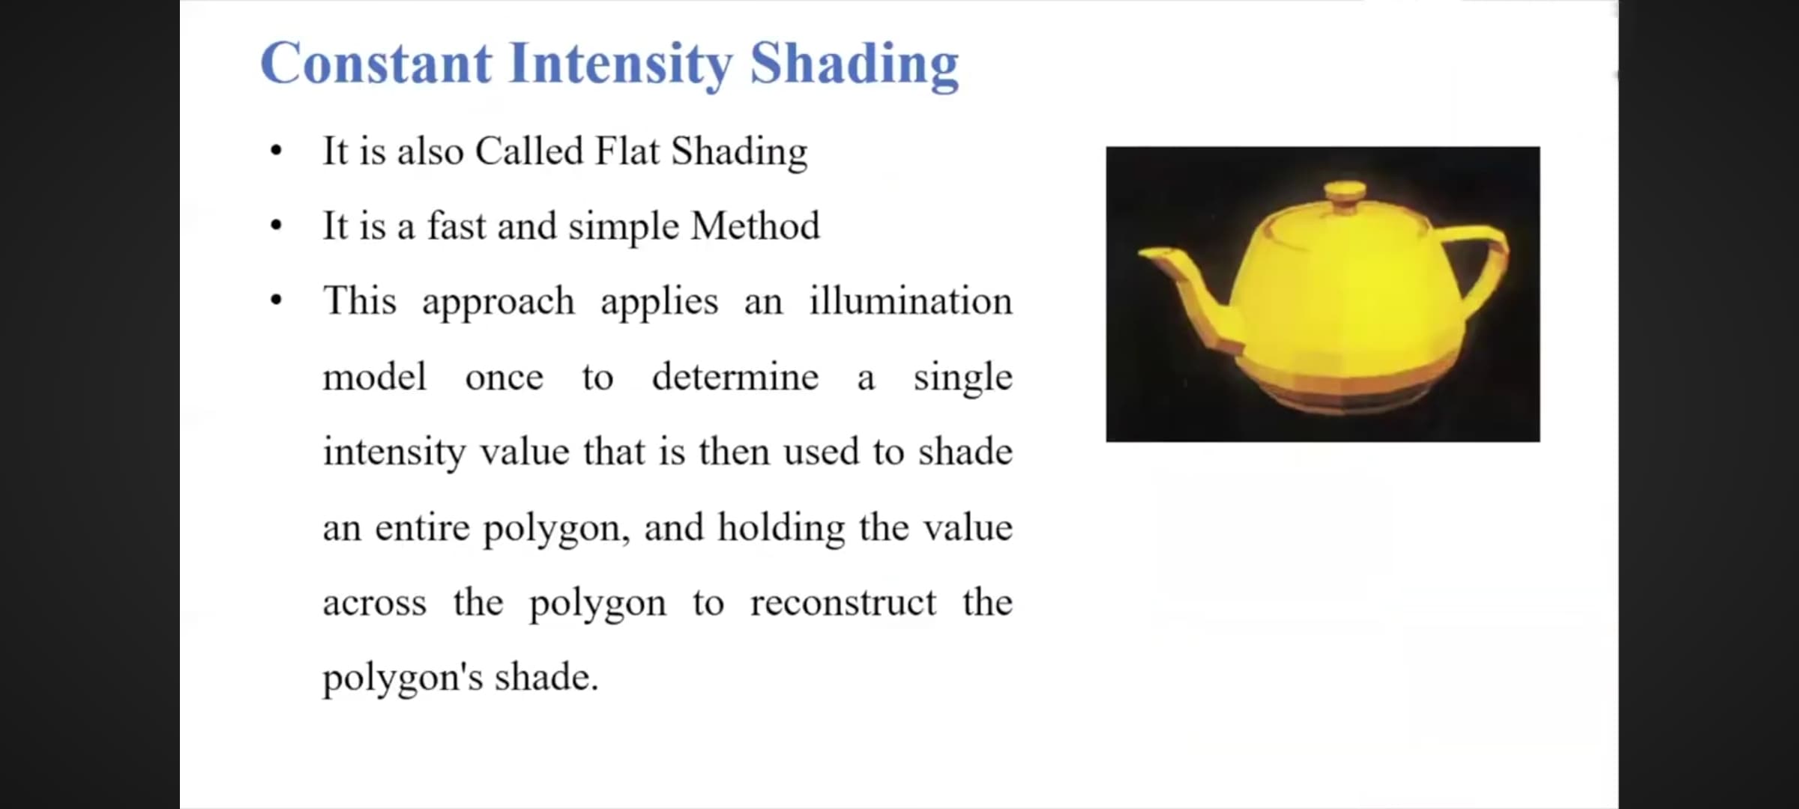

Slide 5
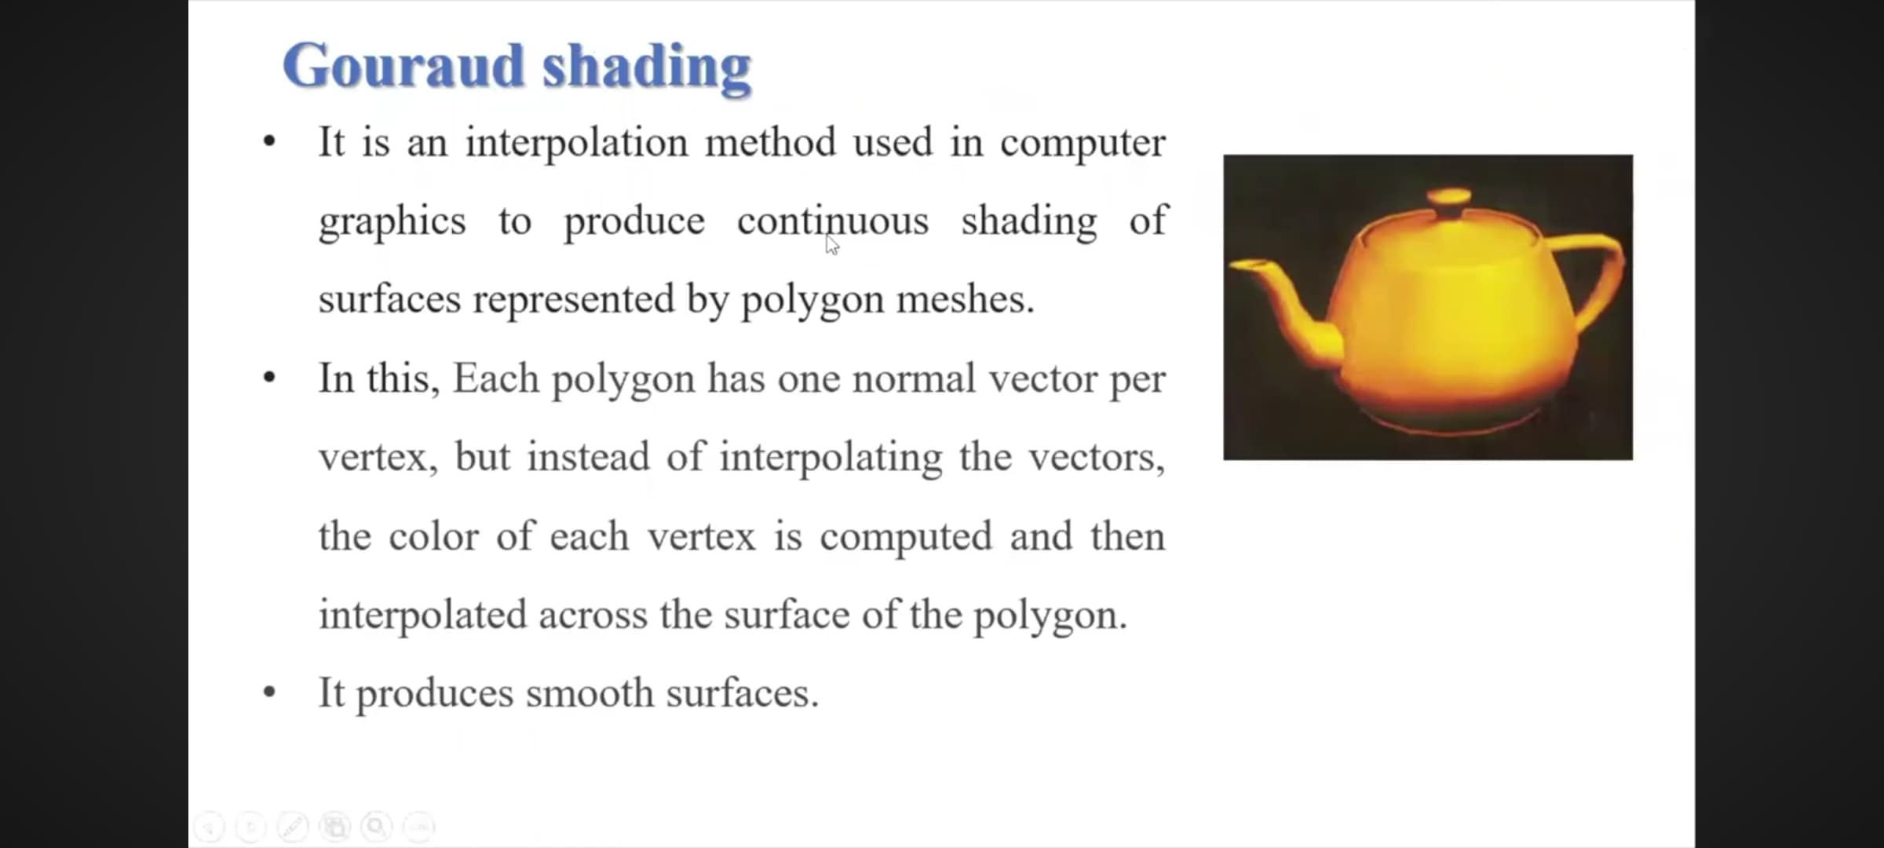
Interpolation is estimating or measuring an unknown quantity between two known quantities
"One normal vector per vertex" means that for each individual point (vertex) on a 3D mesh, there is a single vector that represents the direction perpendicular to the surface at that point

Slide 6
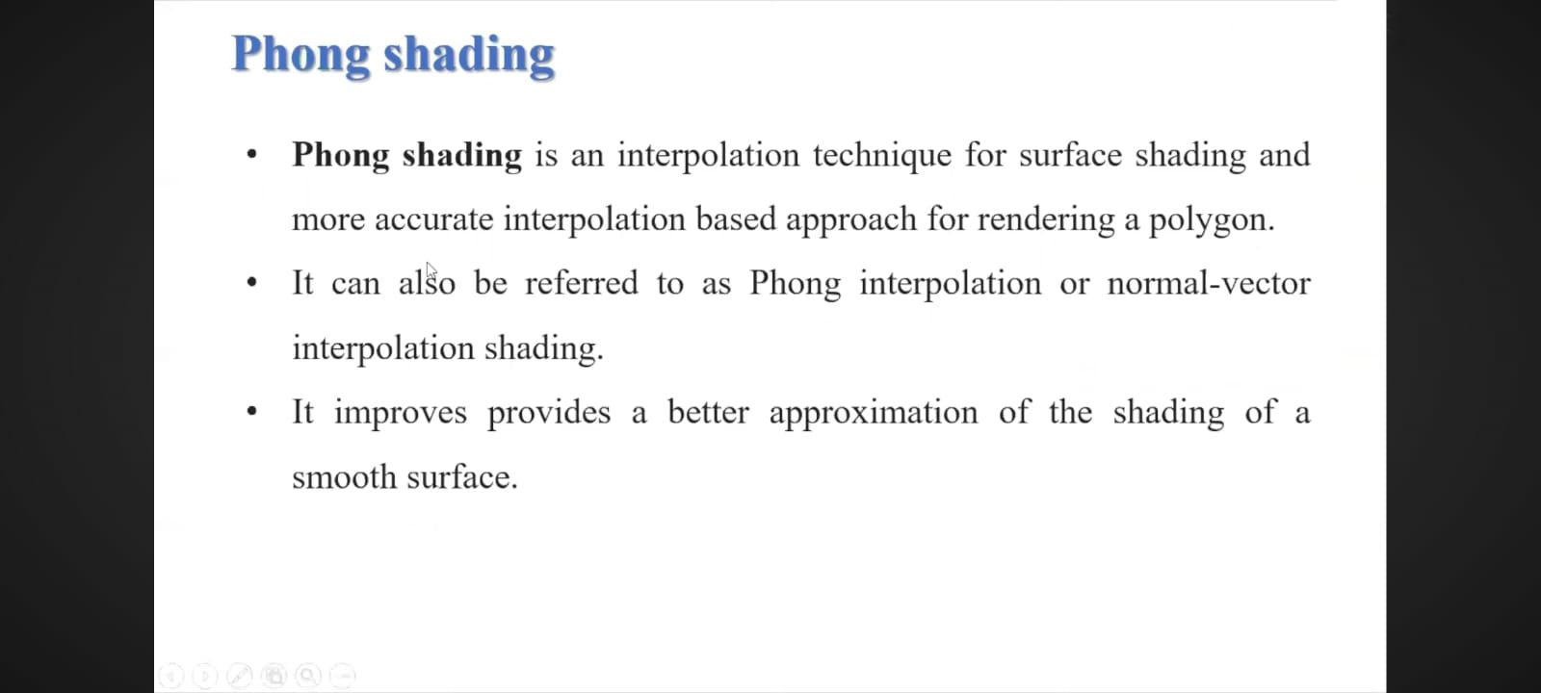

Slide 7
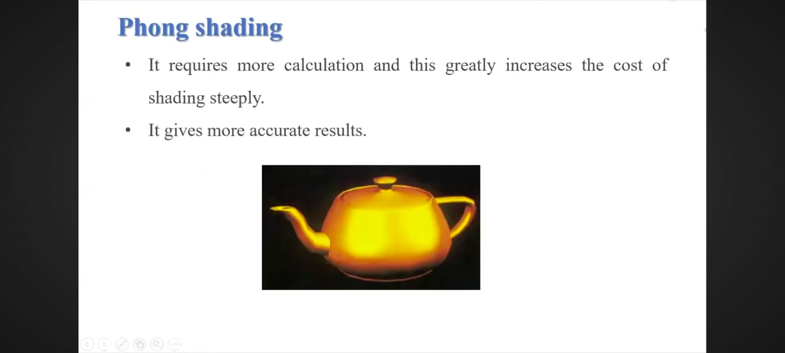

Slide 8
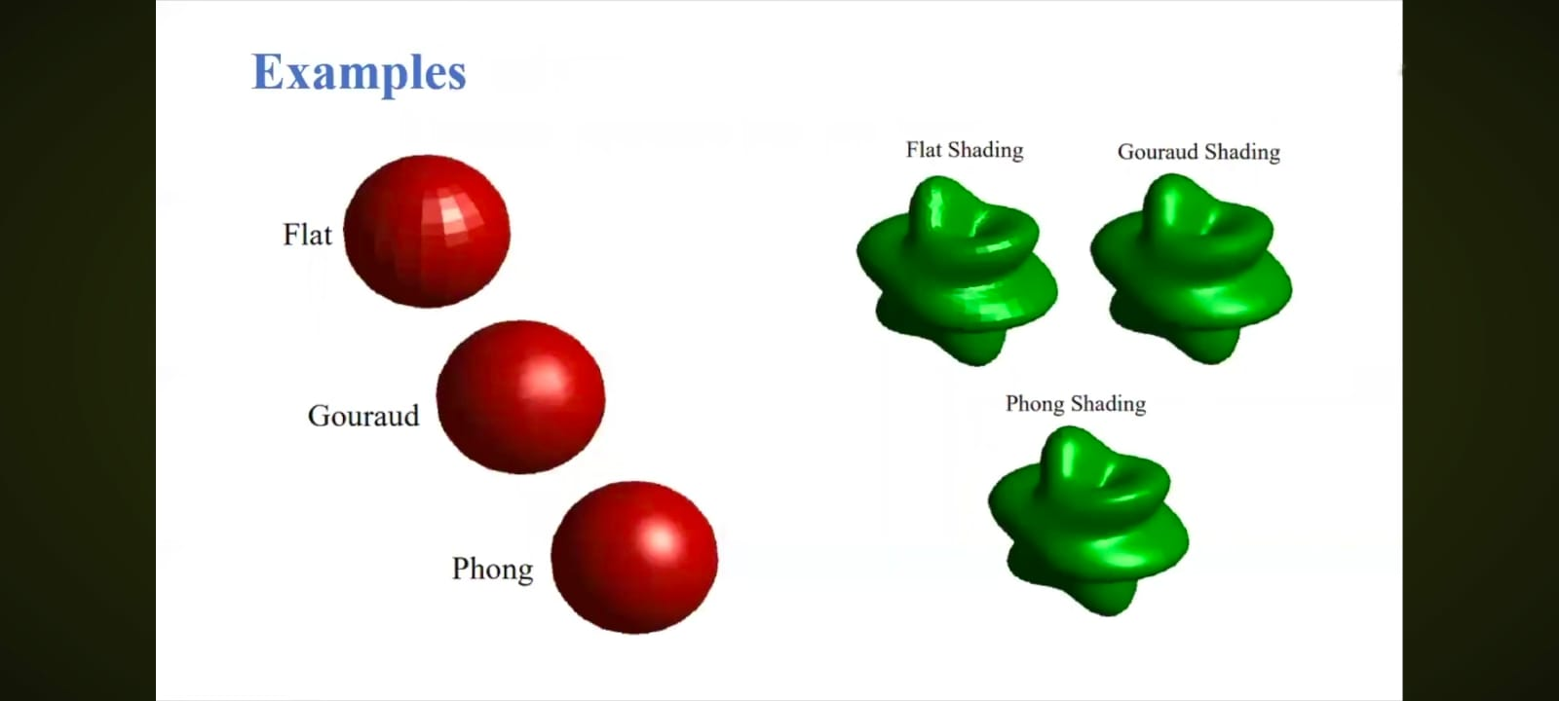

Slide 9
THANK YOU!!

